Slide 1




Securing Container Workloads Build, Sign, Scan, Push, Deploy & VNets
Oh My
Steve Lasker
Program Manager
Azure Container Registries
Steve.Lasker@Microsoft.com
@SteveLasker
SteveLasker.blog
https://github.com/stevelasker

Slide 2
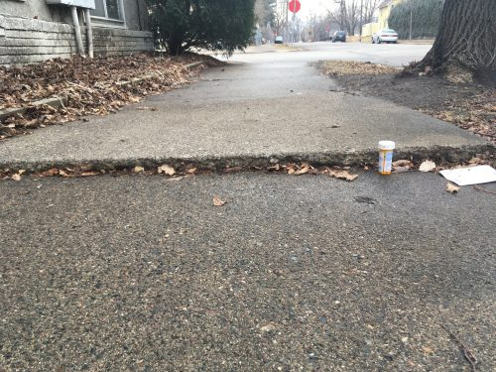
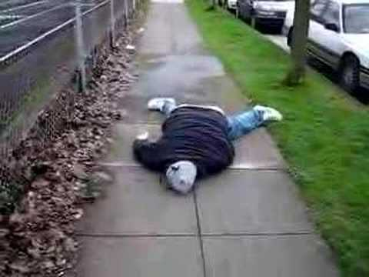
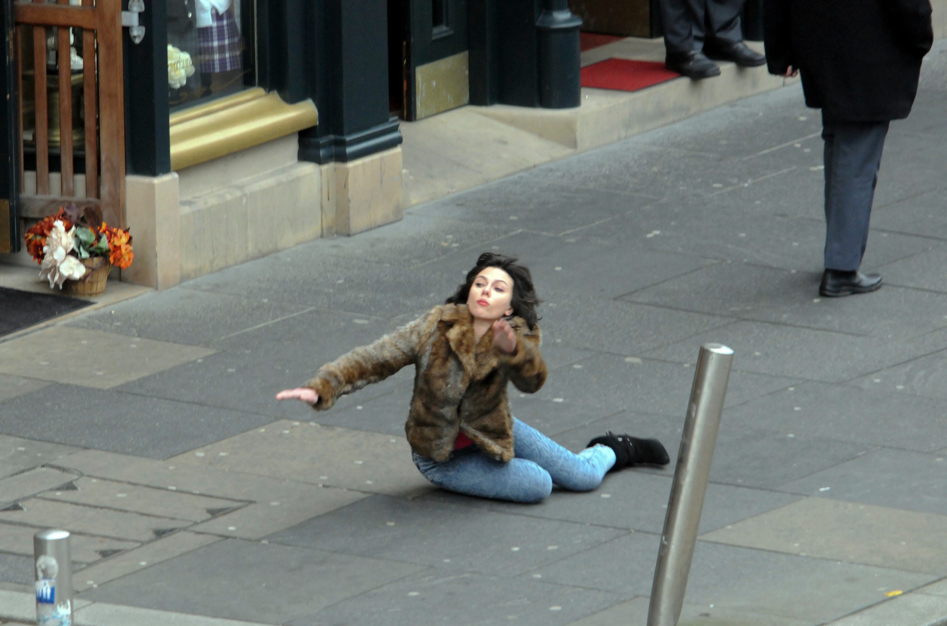
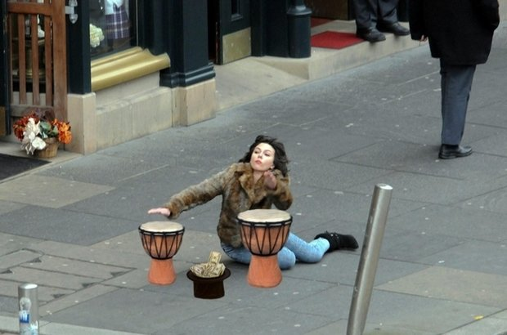
Container Orchestration & Reliability
Designing with the knowledge something will fail at any point

Slide 3

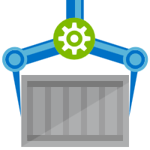
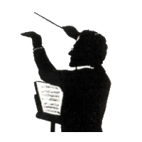
Orchestration Provides Infrastructure Resiliency
Release Management
Resource Pool
Orchestration
HOST-A
Deploy:
web:1 x3
quotes:1 x3
important:1 x4
Image Cache
web:1
digest: 91e
web:1
digest: 91e
Foo:
web:1 x3
quotes:1 x3
important:1 x4
web:1
digest: 91e
quotes:1
digest: u82
Container Builder
Container Registry
important:1
digest: 2re
important:1
digest: 2re
HOST-B
Image Cache
quotes:1
digest: u82
quotes:1
digest: u82
quotes:1
digest: u82
web:1
digest: 91e
important:1
digest: 2re
important:1
digest: 2re
important:1
digest: 2re
quotes:1
digest: u82
quotes:1
digest: u82
docker build –t web:1
docker build –t quotes:1
docker build –t important:1
docker push web:1
docker push quotes:1
docker push important:1
important:1
digest: 2re
important:1
digest: 2re
Image
web:1
quotes:1
important:1
web:1
digest: 91e
HOST-C
quotes:1
digest: u82
Image Cache
important:1
digest: 2re
quotes:1
digest: u82
quotes:1
digest: u82
important:1
digest: 2re
important:1
digest: 2re
Notes:
Orchestrator icon from: http://cdn.marketplaceimages.windowsphone.com/v8/images/f58edb21-b20c-4315-b837-6cee21n442cd?imageType=ws_icon_large
https://git-scm.com/book/en/v2/Git-Branching-Basic-Branching-and-Merging

Slide 4
What are the components of a secured workflow?
Where do you start?

Slide 5
Multiple lines of defense
Authentication & Authorization
Image Buffering
Image Patching
Image and Runtime Scanning
Container Workflows, w/Security
Network Security
Policy & Usability

Slide 6


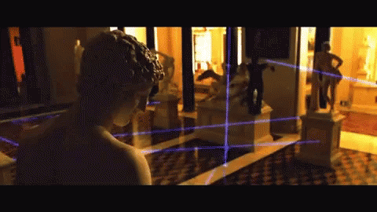
Security isn’t definitive it’s a matter of time, effort and how determined someone is.

Slide 7

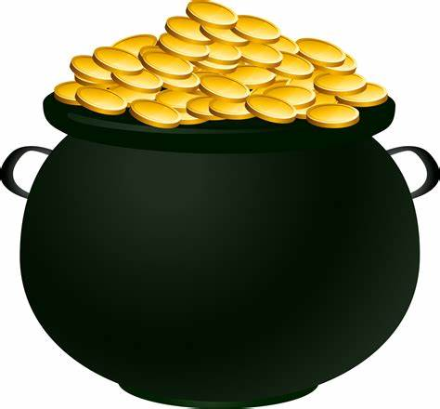
Multiple Lines Of Defense

Slide 8





Authentication & Authorization
Require the most stringent authentication
Users – 2fa
Services – rotatable, revocable, time-based tokens
Provide the least permissions required to get the job done.
Runtime clusters should only be able to pull
CI Systems should be able to push
Teams & clusters should have different permissions
Who can sign images?
Authentication:
Username/Password?
2FA
Token
Certificate
Time based
Revocable?
Permissions:
Read – Pull
Write – Push
Sign – content trust
List – repos and tags
Delete
Update meta-data – expiration date
Users
Services

Slide 9



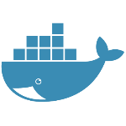











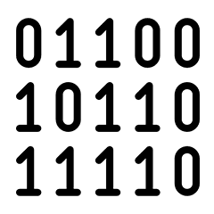
Are Your Base Artifacts Secure?
Images Secure?
Public Registries
Your Environment
aws, azure, google, on-prem, …
FROM demo42.azurecr.io/base-artifacts/dotnet/core/runtime:2.1.10 AS base
WORKDIR /app
FROM demo42.azurecr.io/base-artifacts/dotnet/core/sdk:2.1 AS build
WORKDIR /src
COPY src/Important/Important.csproj src/Important/
RUN dotnet restore src/Important/Important.csproj
COPY . .
WORKDIR /src/src/Important
RUN dotnet build Important.csproj -c Release -o /app
FROM build AS publish
RUN dotnet publish Important.csproj -c Release -o /app
FROM base AS final
WORKDIR /app
COPY --from=publish /app .
ENV VERSION=0.0.25
ENTRYPOINT ["dotnet", "Important.dll"]
FROM microsoft/dotnet/core/runtime:2.1.10 AS base
WORKDIR /app
FROM microsoft/dotnet/core/sdk:2.1 AS build
WORKDIR /src
COPY src/Important/Important.csproj src/Important/
RUN dotnet restore src/Important/Important.csproj
COPY . .
WORKDIR /src/src/Important
RUN dotnet build Important.csproj -c Release -o /app
FROM build AS publish
RUN dotnet publish Important.csproj -c Release -o /app
FROM base AS final
WORKDIR /app
COPY --from=publish /app .
ENV VERSION=0.0.25
ENTRYPOINT ["dotnet", "Important.dll"]
FROM mcr.microsoft.com/dotnet/core/runtime:2.1.10 AS base
Private Registry
acr, ecr, gcr, dtr, harbor, jfrog, …
.NET
demo42.azurecr.io
Docker Hub
FROM mcr.microsoft.com/dotnet/core/sdk:2.1 AS build
Public Internet
Task Image Validation
node
java
MCR
dotnet
ACR Tasks
wordpress
base-artifacts
node
Red Hat
java
dotnet
gcr
wordpress
dev
faclon-team
helloworld
digest: 91e
warriors-team
SCC
Source Code ControL
gpr

Slide 10
Demo Base Artifact Updates
Public Registries
Your Environment
demo42.azurecr.io/hub
Private Registry
demo42.azurecr.io
Docker Hub
Public Internet
Task Image Validation
node
java
MCR
dotnet
ACR Tasks
wordpress
base-artifacts
node
java
dotnet
wordpress
dev
faclon-team
warriors-team
SCC
Source Code ControL

Slide 11
ACR Tasks A primitive of container lifecycle management
Build, Patch, Manage Container Artifacts
aka.ms/acr/tasks

Slide 12

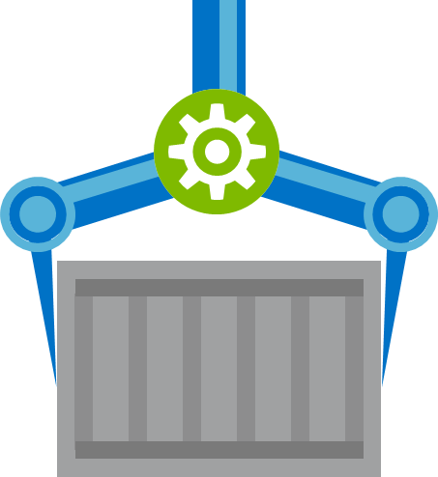


Build
Test
Deploy
Secure

Slide 13






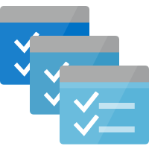








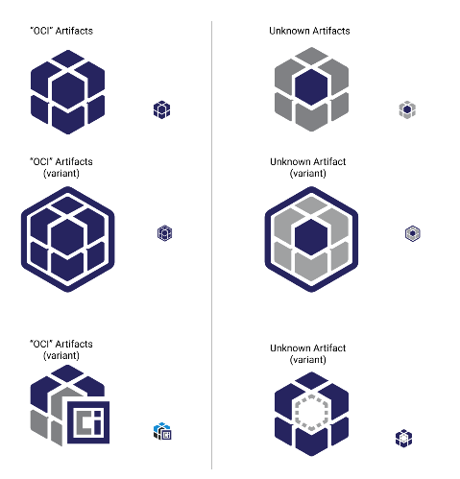

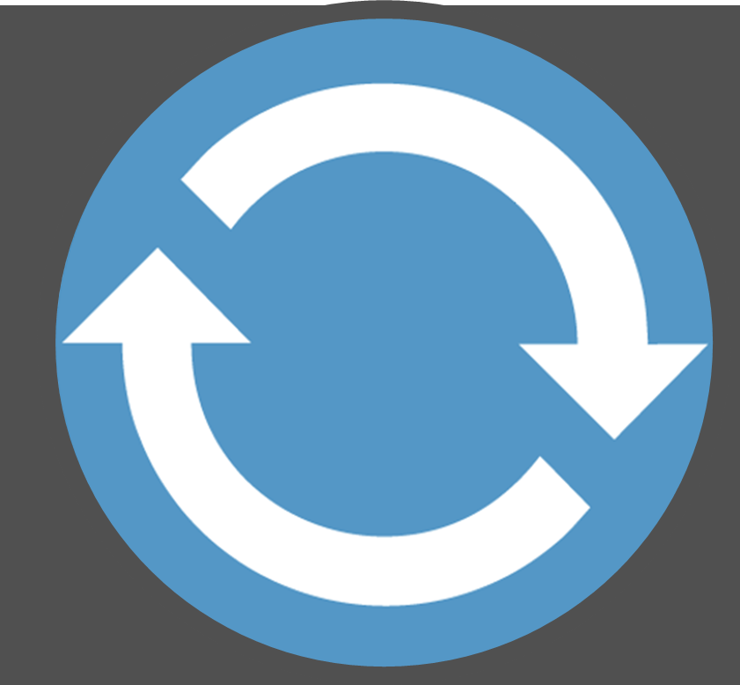


Build, Test, Deploy
Deployments triggered on artifact availability
Secrets
Config
SCC
Source Code ControL
CI
Build, Unit & Integration Testing
Prod
CD Deployments
Virtual Build & Test Environment
Unit Testing
Staging
Helm Chart,
CNAB
Functional Testing
Staging/Prod Registry
Docker Hub
Artifact Security Scanning
git commit
ACR Tasks
Azure Container Registry
Microsoft Container Registry
Inner-Loop
OCI Artifacts
Dev
Run
Code
Validate
Debug
Azure DevSpaces

Slide 14
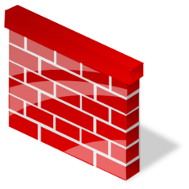

Security Boundaries
Secrets
Config
SCC
Source Code ControL
CI
Build, Unit & Integration Testing
Prod
CD Deployments
Virtual Build & Test Environment
Staging
Dev Registry
Staging/Prod Registry
Docker Hub
git commit
ACR Tasks
Azure Container Registry
ACR Tasks
Azure Container Registry
Microsoft Container Registry
Rules
Inner-Loop
IP: 5.5.1.2
Dev
Run
Code
Validate
Debug
Azure DevSpaces

Slide 15
Post Development
Secrets
Config
OS & Framework Patching
What happens when developers stop making code changes?
CI
Build, Unit & Integration Testing
Prod
SCC
Source Code ControL
CD Deployments
Virtual Build & Test Environment
Staging
Staging/Prod Registry
Docker Hub
git commit
ACR Tasks
Azure Container Registry
Microsoft Container Registry
Inner-Loop
Dev Registry
Dev
Run
Code
Validate
Debug
Azure DevSpaces
ACR Tasks
Azure Container Registry

Slide 16

Container Patching
Secrets
Config
SCC
Source Code ControL
Prod
CD Deployments
Staging
.NET
Staging/Prod Registry
Functional Testing
Docker Hub
Azure Container Registry
Microsoft Container Registry
Central Base Artifacts
Base Image Index
CI
Build, Unit & Integration Testing
ACR Tasks
Azure Container Registry
Unit Testing

Slide 17

Container Patching
Secrets
Config
Unit & Functional Tests provide value for the life of the application
CI
Build, Unit & Integration Testing
Prod
SCC
Source Code ControL
CD Deployments
Virtual Build & Test Environment
SAVE
Unit Testing
Staging
.NET
Staging/Prod Registry
Functional Testing
Docker Hub
Base Image Index
ACR Tasks
Azure Container Registry
Microsoft Container Registry
Central Base Artifacts
Base Image Index
CI
Build, Unit & Integration Testing
ACR Tasks
Azure Container Registry
Unit Testing

Slide 18

VNET & Firewalls
Securing registry access to private virtual networks

Slide 19




VNet & Firewall Rules
Is authentication & authorization enough?
Least required privileges apply to the network as well
Registries in the Vnet
Whitelist IP ranges that should have access
AKS
Public Internet
Node1
Node2
Node3
Azure virtual network
Azure virtual network
IP: 5.5.1.2
Rules
ACR
Other Resources
IP: 10.2.1.3
IP: 5.5.1.2
IP: 10.2.1.3
http://aka.ms/acr/vnet

Slide 20
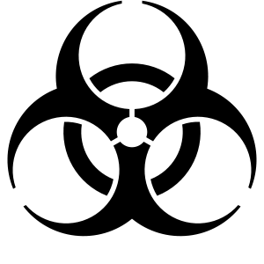
Container Registries Secured by Default
Assuring a registry has images that are scanned and considered secure enough
The Container Quarantine Pattern

Slide 21

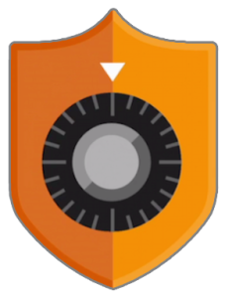


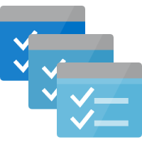
Secured By Default
Build/Push
Azure Container Registry
Container Hosts
Quarantine Tag
Digest
Tag
91efj6
:1.0
:1.1
u82lq
:1.2
e8s1f

Slide 22

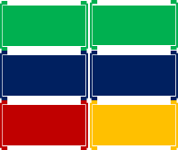
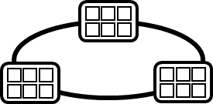
Container Service
Run, Manage
1
Release Management
Container Instances
docker push acrdemos.azurecr.io/th:1.0
Azure Container Registry
Production
environments
Lock down images that are vulnerable
Secure registries by default
Protect unprotected nodes – like developers
App Services
5
6
2
{
"id": "0d799b14-404b-4859-b2f6-50c5ee2a2c3a",
"timestamp": "2018-02-28T00:42:54.4509516Z",
"action": "push-quarantined",
"target": {
"size": 1791,
"digest": "sha256:91ef6
"length": 1791,
"repository": “th",
"tag": "1.0"},
"request": {
"id": "978fc988-1e06-49ee-bf71-4f6e331d1591",
"host": “acrdemos.azurecr.io",
"method": "PUT"}
}
{
"id": "0d799b14-404b-4859-b2f6-50c5ee2a2c3a",
"timestamp": "2018-02-28T00:42:56.4509516Z",
"action": "push",
"target": {
"size": 1791,
"digest": "sha256:91ef6
"length": 1791,
"repository": “th",
"tag": "1.0"},
"request": {
"id": "978fc988-1e06-49ee-bf71-4f6e331d1591",
"host": “acrdemos.azurecr.io",
"method": "PUT"}
}
Tag
Digest
91efj6
u82lq
e8s1f
3r2s7
Quarantine Tag
:1.0
:1.1
:1.0
:1.0
3
docker pull th@sha256:91ef6
4
az acr policy set –n acrdemos --quarantine-remove –-image th@sha256:91ef6
or
az acr policy set –n acrdemos --quarantine-block –-image th@sha256:91ef6
Notes:
{
"id": "0d799b14-404b-4859-b2f6-50c5ee2a2c3a",
"timestamp": "2018-02-28T00:42:54.4509516Z",
"action": "push-quarantined",
"target": {
"mediaType": "application/vnd.docker.distribution.manifest.v2+json",
"size": 1791,
"digest": "sha256:91ef6
"length": 1791,
"repository": “th",
"tag": "1.0"
},
"request": {
"id": "978fc988-1e06-49ee-bf71-4f6e331d1591",
"host": "jengademos.azurecr-test.io",
"method": "PUT",
"useragent": "docker/18.03.0-ce-rc1 go/go1.9.4 git-commit/c160c73 kernel/4.9.75-linuxkit-aufs os/linux arch/amd64 UpstreamClient(Docker-Client/18.03.0-ce-rc1 \\(windows\\))"
}
}

Slide 23
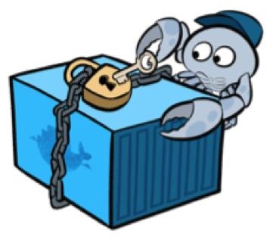
Docker Content Trust Image Signing
Assuring an image validation source to destination

Slide 24






ACR Content Trust
Content Trust Preview added September ’18, now GA
Images signed at the source, stored in ACR, validated on the client
Content Trust based on the source, not the actual content
We need a signing of actual content solution
Some work in progress
docker push
docker pull
acr
 Content Trust Enabled,
api
api
Images
Signatures

Slide 25
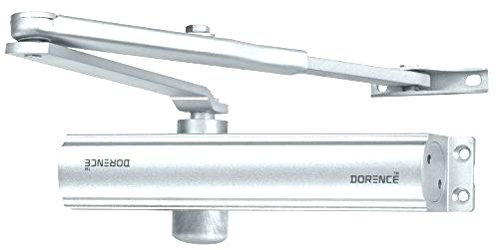

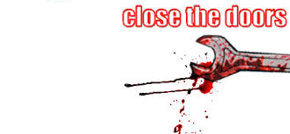
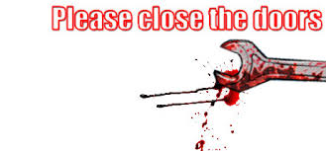

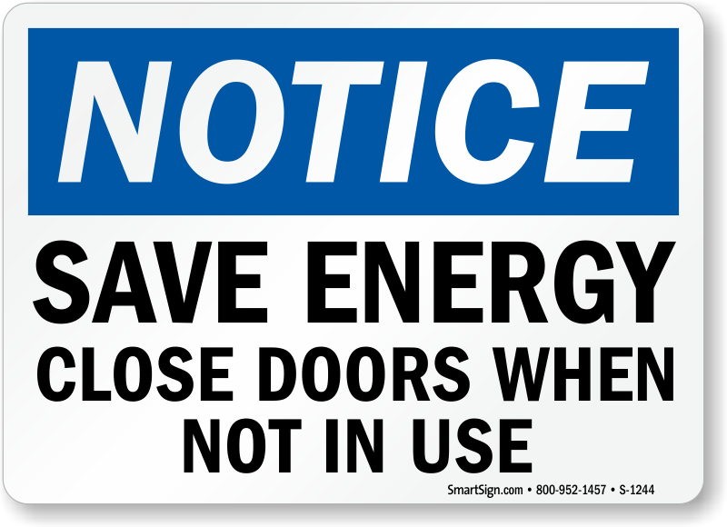
Policy & User Experience
Engage the good people to help with policy
Make it easy to do the right thing
…difficult to do the wrong thing
KEEP US SECURE
Lock Doors Upon Leaving

Slide 26
Wrapping up
Security isn’t just one thing
Predict what’s possible, not just what’s happened
Apply minimal privileges and access, balancing users needs
Protect from the bad people, enable the good people
Don’t wait for the aftermath cleanup
Enforce policy for where to pull images from
Scan & secure base images
Scan & secure your images
Secure nodes
Keep scanning images for new vulnerabilities
Monitor network traffic, not just static images

Slide 27
Thank You
ACR Tasks aka.ms/acr/tasks
ACR Import aka.ms/acr/import
ACR Links aka.ms/acr/links
Presentations aka.ms/acr/presentations
Quarantine Pattern aka.ms/acr/Quarantine
Choosing a Registry stevelasker.blog
Steve Lasker
Program Manager
Azure Container Registries
Steve.Lasker@Microsoft.com
@SteveLasker
SteveLasker.blog
github.com/SteveLasker
github.com/SteveLasker/presentations

